Slide 1
YAMS
Adam Brinley Codd
Ben Cotter
James Milns
Qian Qiao
Sridhar Saronbat
Simon West
Notes:
YAMS is a MIPS simulator, partly customized for the compilers course – limited instruction set and displays useful statistics.
Currently, SPIM is used, nasty user interface, no statistics.

Slide 2
YAMS
XML
Lexer and Parser
Assembler
Processor
Graphical User Interface
Demonstrations
Conclusion
Notes:
Our presentation will focus on:
XML – what we use it for
Lexer and Parser – Joe
Assembler – Me
Processor – Simon
Graphical User Interface – Me
Demonstrations – Ben and Sridhar
Jimmy will show how to add an instruction to the instruction set using the XML file

Slide 3
XML File
Contains the Instruction set
Used to generate Parser, Instruction Handler
Used at runtime by Assembler
Notes:
XML file contains information on the entire instruction set
Information to parse, assemble and execute each instruction
The parser and instruction handler (in the processor) are generated at compile time
The assembler reads the XML file at runtime for information on how to encode each instruction into machine code

Slide 4
Overview
Load Code from File
StringBuffer
Parse the Code
LineList
Assemble the Code
MemoryManager
Filled
Start Processor
Notes:
Rough idea of what’s going on:
Controller loads assembly code from file into a StringBuffer
Parser parses the code and produces a LineList object
Assembler assembles and loads the code into our MemoryManager
Processor is started

Slide 5
Lexer and Parser
Program input
Tokenize
Parse
(errors)
LineList

Slide 6
Lexical Tokenizer (Lexer)
Tokenizes at initializing time
Returns original inputs
mark() and rewind()

Slide 7
mark() and rewind()
Expr := A B C D E
Expr2:= A B C D F
Tradition ways:
  Store A, B, C, D
  Test E || F
  Retrieve A, B, C, D
  Start parsing

Slide 8
mark() and rewind()
Expr := A B C D E
Expr2:=A B C D F
Yams way:
  Set mark at A
  Go on until making a choice is possible
  Rewind
  Start parsing

Slide 9
Parser
Parse the label?
Parse the instruction?
  Parse the operands (done in a separate class)
Return the Line

Slide 10
XML
Instruction_file.xml
parser.xslt
Parser.java
Parser.class

Slide 11
Why?
Less knowledge required
Less time consuming
Less work

Slide 12
Assembler
Intermediate stage, taking internal representation of the User MIPS Code and writing the binary equivalent to the processor memory ready for executing.
Input: List object containing instructions
Output: 32 Bit Machine Words
Notes:
Assembler converts list of instructions into machine code.
Only loading one file at a time, therefore no linking between files is needed, so our assembler can load the file directly into our Memory Manager as it assembles it

Slide 13
Implementation
Table Initialisation
Phase 1: First Pass Assembling
Phase 2: Second Pass Assembling
Notes:
Three parts:
Initalise tables
Need to do two passes, second pass resolves symbol names which we weren’t able to resolve on the first pass

Slide 14
Table Initialisation
Creation and initialisation of tables required during the Assembly process.
Instruction Table
Symbol Table
To-Be-Done Table
Instruction
Table
XML File
Repository
XML File
Handler
Notes:
Instruction table – generated from the XML file, stores the machine code representation of each instruction and information on how to encode the operands
Symbol table – contains labels and their addresses, used to resolve label names
To be done table – as we shall see, not all instructions can be assembled on the first pass, these are put into the to be done table and assembled on the second pass

Slide 15
Assembling: PHASE 1
Label?
Instruction?
Get Next Line
No
No
Yes
Yes
Add Current
Address
To Symbol Table
Encode
Operands
Symbol
Table
Miss?
Yes
No
Add to To Be
Done Table
Operand
Substitution
Write To
Memory
Notes:
First pass
Go through each line
If it’s a label, add it’s address to the symbol table
If an instruction, try to encode operands
If there are symbols (labels) in the operands which cannot be resolves (declared later) then add it to the to be done table
Otherwise encode operands (example later) and write to memory

Slide 16
Assembling: PHASE 2
Instruction?
To-Be-Done
Table
Get Next
Instruction
No
Yes
Encode
Operands
Symbol
Table
Miss?
Yes
No
ERROR: Label Does
Not Exist
Operand
Substitution
Write To
Memory
Notes:
Second pass
Go through the to be done table
Encode as before
If we still can’t find the symbol in the table then it doesn’t exist in the file and we must throw an error
Assembler cannot continue

Slide 17
Example
addi $a1, $a1, 20
addi rd, rs, imm
Operand Encoding
Substitution
001000bbbbbaaaaacccccccccccccccc
rs
rd
imm
$a1 = 00101 5 bits
20 = 0000000000010100 16 bits
00100000101001010000000000010100
Notes:
So here is quite a simple example of how the assembler works, this time we are considering an addi instruction:
So we want to add the immediate value of 20 to the register $a1
Within the xml, there is an underlying machine code representation for the “addi” instruction
As can be seen here:
this representation has character strings in the places where the encoded operands will go:
“a” represents the first operand rd
“b” the second rs
And “c” the immediate operand
The next stage is encoding the actual operands of the given MIPS instruction so we can replace our strings of as and bs and cs with the actual operands:
$a1 is known to the processor by this binary representation
And 20 can be encoded into 16 bits leaving this representation.
We now perform the substitution giving us this final 32 machine code word that we can write to memory and that the processor will interpret correctly.

Slide 18
Processor - Introduction
The Processor is the simulation engine inside YAMS.
It comprises of classes which replicate the behaviour of a MIPS R3000 CPU.
The Processor reads instructions from main memory, decodes and executes them.
The MIPS has a RISC architecture, and a key feature is that all of its instructions are 32 bits (a MIPS word) in length.

Slide 19

Processor - Overview
XML
Instruction
File
Cycle
Manager
Instruction
Decoder
Memory
Manager
XSLT
Register
Manager
Processor
Instruction
Handler
System Call
Handler
Statistics
Manager
The components of the YAMS Processor

Slide 20
Processor Modules pt. I
Memory Manager
  store/retrieve of bytes and words
  3 segments (text, data and reserved)
  Intelligent memory usage
Register Manager
  access procedures for the MIPS CPU’s registers and
  program counter

Slide 21
Processor Modules pt. II
Cycle Manager
  controls the execution of each processor cycle
  manages breakpoints
Instruction Decoder
  distinguishes between normal and ‘syscall’ instructions
Instruction/Syscall Handler
  decodes and executes instruction

Slide 22
A Typical Execution
The Cycle Manager has responsibility for sequencing the operations required in executing an instruction:
Cycle
Manager
decode(inst)
Instruction
Decoder
execute(inst)
Instruction
Handler
System Call
Handler
getReg(“PC”)
getLocation(address)
Register
Manager
Memory
Manager

Slide 23
Instruction Handler pt. I
No instructions are hard-coded in YAMS source code
Instruction Handler is auto-generated from the XML instruction using an XSLT transformation
The transformation analyses the machine code representation of each instruction to determine how to detect the instruction

Slide 24
Instruction Handler pt. II
The semantics of each instruction are captured by the code written in the <Javacode> tag in the source XML
This Java can be coded to the interfaces of the Processor components, e.g. MemoryManagerInterface, RegisterManagerInterface
This approach is extremely flexible

Slide 25
Statistics
The Statistics Manager produces statistics on the following:
individual register usage
memory in use (data segment)
execution count for each line
instruction count

Slide 26
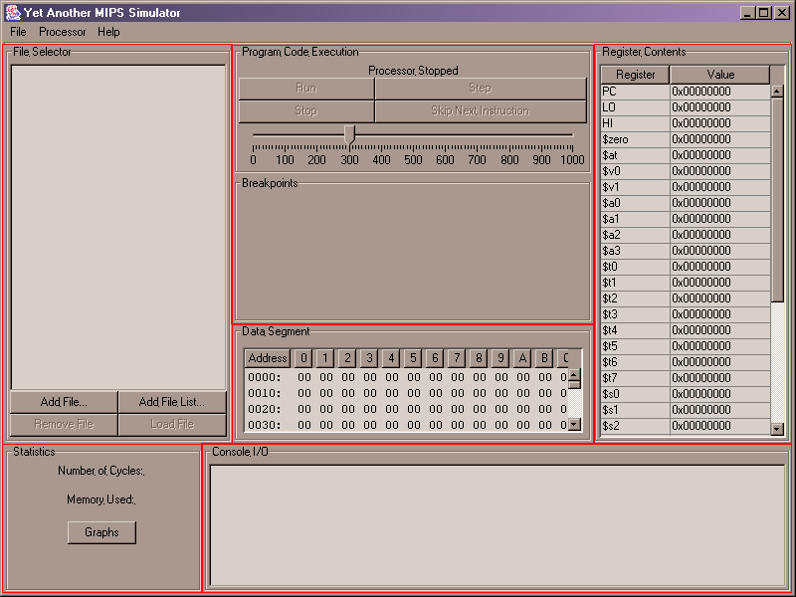
Graphical User Interface
File Selector
Program Code
Data Segment
Register Contents
Statistics
Console I/O
Notes:
Main window is split into 6 panels, each with a different task
FileSelector uses a simple Jlist
Program Code uses some buttons, a slider, and a Jtable to display the code and breakpoints
DataSegment uses a JHexTable which we found on the web
Register contents displays live register values – has an update method which is called when register values change
Statistics displays some simple statistics – pressing graph displays a few bar charts of register and instruction usage – demonstrated later
Console I/o – displays output from the processor, uses an extension of an OutputStream class so that the processor’s output can be redirected either to a null output stream, standard out, or this console window

Slide 27
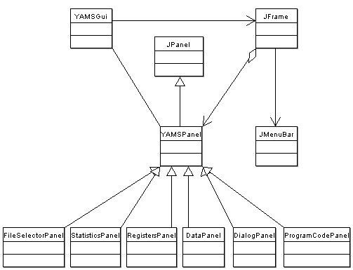
Graphical User Interface
Notes:
All panels extend a YAMSPanel
Yams Panel draws the border
All contained in a JFrame
YAMSGui creates the main frame and MenuBar
YAMSGui contains all the access and control methods for the panels such as ….

Slide 28
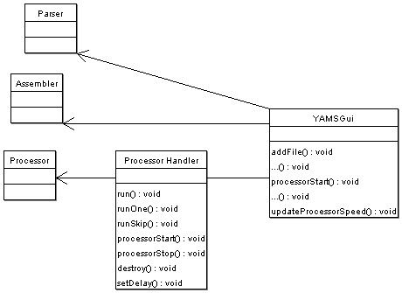
Graphical User Interface
Processor Handler
Runs in separate Thread
Controls running of the processor
Notes:
YAMS Gui also contains a processor handler – seperate thread to control running of the processor
Required so that the GUI can execute instructions in a loop whilst still being able to respond to other events
Able to run continously, run one line, or skip a line.

Slide 29
Demonstrations

Slide 30
Extension: Instruction Addition
Flexibility of YAMS
Notes:
YAMS was designed to be a flexible application, and one of our priorities was making sure that advanced users could add their own instructions and extend the functionality of the framework as much as they wanted to.

Slide 31
XML Repository
Centralise all data regarding an instruction
Information used by
  Parser
  Assembler
  Processor
Notes:
Adding an instruction could feasibly be a lengthy task, since there would be multiple locations within the software where changes would have to be made. Therefore it was important to be able to centralise all the data regarding an instruction, and build YAMS such that it would use this central data and behave accordingly.
As has already been discussed, we build an XML Repository file that would store the specific data on each of the instructions that YAMS would support. The advantage of using this structure is that to add an instruction, changes would ONLY need to be made to this XML file, rather than in multiple areas of the software.
While the user would only have to make changes to one location, the data stored in this location would be used by the three main software components of the underlying MIPS simulator:
1stly the Parser would have to have specific handlers to know how to recognise the new instruction in terms of its name and allowable operands.
2ndly the Assembler would need to have specific information regarding the machine code representation of the new instruction, so that it could write machine code to main memory.
And finally the Processor would need to have handlers to recognise and deal appropriately with each instruction.

Slide 32
Advantages
Flexible – supports diff instruction types
  Regular
  Extended
  Pseudoinstructions
Centralised repository, enables easy adding of instructions
Notes:
Building YAMS so that it behaved as described by data within an XML file had complications during implementation but had fundemental advantages:
Firstly and most importantly it made the application very flexible, allowing a variety of different types of instructions to be implemented in the future in whichever way the user saw fit:
They could add new Regular instructions which had only one set of possible operands and one behaviour
They could add other Extended instructions that could perform the same function on a variety of different operand combinations e.g. you could have an sub instruction which firstly worked on only register operands, and another representation of the same command to work on an immediate operand as well.
Thirdly, it would be possible to quickly define Pseudoinstructions within the XML, creating brand new instructions out of existing ones
So then, by reading this XML file, YAMS could be made more flexible for advanced users.
Secondly, as we have already mentioned, by placing all this data in the same location, it makes adding instructions much easier and doesn’t require that the user have full knowledge of how the full application operates.
Im going to show you the actual XML Instruction repository for YAMS before I move further into the demonstration: and there you can see the instructions already supported by YAMS

Slide 33
Demo:
Instruction_file.xml
Notes:
Here is the xml repository of instructions, contains all supported instructions

Slide 34
<Instruction>
<Instruction>
<Name></Name>
<OperandTypes></OperandTypes>
<Javacode></Javacode>
<Type fixedRt=“true”></Type>
<MachineCodeRepresentations>
<Representation>
<OperandsCoding></OperandsCoding>
<MachineCode></MachineCode>
<Operands>
……
</Operands>
</MachineCodeRepresentations>
<Help>
<FullName></FullName>
<Format></Format>
<Description></Description>
</Help>
</Instruction>
Notes:
On the screen here we can see the basic XML layout of an instruction, and all the existing structures within YAMS have been defined using this format.

Slide 35
Example: Add Pseudoinstruction
muli rdest, imm1, imm2
Multiplication of two 16 bit immediates placing answer in destination register
<Name>muli</Name>
<Type>Pseudoinstruction</Type>
Notes:
Now we are going to consider an example of how to add a brand new PseudoInstruction to YAMS, just to indicate that it is perfectly possible.
So we are going to consider adding a brand new Pseudoinstruction “muli.” This is meant to be an extension to the multiplication abilities of YAMS, allowing the multiplication of two 16 bit immediates, placing the result in a destination register.
This feature is currently not supported by YAMS, and as you can see there is no “muli” instruction present as yet. Thus we have to add another <Intstruction> tag and associated sub values:
Now included with the YAMS package is a full user guide to adding an instruction to the framework, and I am just going to briefly run through adding this instruction to show you the potential of the system. The user guide goes into far more detail and explains in detail the allowable values that each of the tags within the XML are allowed to take.
Straight away we can pick out the <Name> and <Type> tags, and fll those in.
The next job is to fill in the information regarding the operands that the parser needs to be able to recognise whether the instruction is syntactically correct or not.

Slide 36
Demo:
NO “muli” in Instruction_file.xml
Error thrown when encounter instruction
Notes:
I will now show you that YAMS doesn’t contain the muli instruction and that when we run the current build upon an assembly file using the muli instruction it wont work:
SHOW ASSEMBLY FILE
So this assembly file simply multiplies two immediate 2 and 10 and places the answer in register $a3.
SHOW RUNNING GUI VERSION ON ASSEMBLY FILE
So the parser doesn’t recognise this instruction, it hasn’t been updated to cope with it.
So we need to add an instruction of the format ive already should to the instruction file filling in the tags.

Slide 37
Parser Operands
muli rdest, imm1, imm2
OPERAND | PARSER TYPE
rdest | Operand.TYPE_REGISTER
imm1 | Operand.TYPE_IMMEDIATE
imm2 | Operand.TYPE_IMMEDIATE
Notes:
We need to make MODIFICATIONS FOR THE PARSER, so it can parse the MIPS file.
So our three operands for the “muli” instruction we want to add are:
rdest
imm1
imm2
Now rdest is a REGISTER operand, and the value that will need to go into the XML so the parser can recognise this is shown in the table to be Operand.TYPE_REGISTER.
For both imm1 and imm2, they are both immediates and the parser will require the Operand.TYPE_IMMEDIATE.
We can now take this information and add it to the <Instruction> tag that we have within the <OperandTypes> tag that the parser uses.

Slide 38
Assembler Operand Definition
muli rdest, imm1, imm2
OPERAND | TYPE | CODED TYPE
Rdest | REGISTER | 1
Imm1 | 16 BIT IMMEDIATE | 0
Imm2 | 16 BIT IMMEDIATE | 0
<OperandCode>100</OperandCode>
Notes:
We now consider what information that the Assembler will need for this “muli” instruction.
We need to explain some more detail regarding the operands and their specific types, since we are going to uniquely define a behaviour for this instruction with this set of operands.
rdest is a register and we don’t really need further detail for this, and registers are represented to the assembler by a “1”
imm1 and 2 are going to be 16 bit immediates, so we represent these by “0”s
We can now uniquely index this representation by the instruction name “muli” and the operand code “100” showing the types of the operands.
But since these are immediates, YAMS must require some more information to be able to translate them correctly during assembly:

Slide 39
Assembler Operands
muli rdest, imm1, imm2
Two immediates (define as 16 bit)
imm1
<Op>
<Number>2</Number>
<Type>0</Type>
<Mask>1111111111111111</Mask>
<EncodeBits>16</EncodeBits>
<OutputBits>16</OutputBits>
<OffSetMode>2</OffSetMode>
</Op>
imm2
<Op>
<Number>3</Number>
<Type>0</Type>
<Mask>1111111111111111</Mask>
<EncodeBits>16</EncodeBits>
<OutputBits>16</OutputBits>
<OffSetMode>2</OffSetMode>
</Op>
Notes:
For the two 16 bit immediates we need to tell the assembler:
<Number> - which operand it is, in this case imm1 is the 2nd operand
<Type> - the type of the oeprand, in this case imm1 and 2 are 16 bit operands, coded as TYPE “0”
<EncodeBits> - the number of bits we want to encode the immediate to, in this case the number must fit into 16 bits
<Output Bits> - the number of bits we want to actually substititute into the final machine code
<Mask> - for some operands we may want to encode to say 16 bits, but then ignore the low level bits, say for a jump instruction where we assume the jumps will always be in multiples of 4. In these cases we can specify directly which bits get included in the string we are going to substitute into the final machine code
<OffsetMode> - we use this field for when we are calculating offsets, in this case there are no offsets to consider so we use “2” which means absolute addressing
So once we have filled out the information for these two immediates, we can add all the operand information to the <instruction> structure

Slide 40
Assembler Machine Code
muli rdest, imm1, imm2
INSTRUCTION | MACHINE CODE
li $at, imm1 | 00100000000aaaaabbbbbbbbbbbbbbbb
li rdest,imm2 | 0010000000000001cccccccccccccccc
mult rdest, $at | 000000aaaaa000010000000000011000
mflo rdest | 0000000000000000aaaaa00000010010
Notes:
The final thing to work out is the machine code for the instruction:
Muli can be broken down into four stages:
we load imm1 into our spare register $at
Next we can load imm2 into rdest register
Then we perform a multiplication on these two registers, which leaves the answer in the “lo” register in the processor
So we then move the value from the “lo” register to our rdest register
Now we have worked out the instructions, we translate that to machine code as seen on the screen, and add it to the <machineCode> tag within the instruction.

Slide 41
Demo:
Add finished “muli” to Instruction_file.xml
Notes:
So we can now add our finsihed <instruction> to the Instruction_file.xml in the project:
ADD INSTRUCTION FILE

Slide 42
Building
Ant build:
  XSLT To Rebuild Parser Handler
  XSLT To Rebuild Processor Instruction Handler
  Compile YAMS
Notes:
Now we must rebuild the project, this is done through “ant” using a build file.
DEMO
All you need simply do as an advanced user is to type “ant” with the new instruction, and the build will take place, and the new instruction will then be available.
The ant build performs two XSLT transformatins

Slide 43
Conclusions
Better than Xspim!

Slide 44
Merry Christmas
Thanks to Adam, for all his hard work, skill and effort, and to the rest of the group, for doing some stuff.
No, really.

